Slide 1

The Community and the Corporation
Chapter 18
©2020 McGraw-Hill Education. All rights reserved. Authorized only for instructor use in the classroom. No reproduction or further distribution permitted without the prior written consent of McGraw-Hill Education.

Slide 2


The Business–Community Relationship
Community: A company’s area of local business influence.
Civic engagement: The active involvement of businesses and individuals in changing and improving communities.
Community relations: The organized involvement of business with the community.
Notes:
The Business–Community Relationship
Community: A company’s area of local business influence.
Whether a business is small or large, local or global, its relationship with the community or communities with which it interacts is one of mutual interdependence.
There are expectations on both sides.
The Business Case for Community Involvement
Civic engagement: The active involvement of businesses and individuals in changing and improving communities.
Reasons for community involvement
1. Major way to carry out corporate citizenship mission.
2. To win local support for business activity, be granted an informal “license to operate” in the community.
3. Helps to build “social capital.”
Social capital: the norms and networks that enable collective action.
High levels of social capital enhance a community’s quality of life.
Community relations: The organized involvement of business with the community.
Community relations departments are typically involved with a range of responsibilities:
Employee volunteer programs.
Sustainability reporting.
Corporate giving.
Stakeholder engagement.
Disaster preparedness.

Slide 3
The Firm and Its Communities
From Figure 18.1
Copyright © McGraw-Hill Education. Permission required for reproduction or display.
Community | Interest
Site community | Geographical location of a company’s operations, offices, or assets.
Fence-line community | Immediate neighbors.
Virtual communities | People who buy from or follow the company online.
Communities of interest | Groups that share a common interest with the company.
Employee community | People who work near the company.

Slide 4
What the Community and Business Want From Each Other
From Figure 18.2
Copyright © McGraw-Hill Education. Permission required for reproduction or display.
Business Participation Desired by Community | Community Services Desired by Business
Pays taxes | Schools—a quality educational system
Provides jobs and training | Recreational opportunities
Follows laws | Libraries, museums, theaters, and other cultural services and organizations
Supports schools | Adequate infrastructure, e.g., sewer, water, and electric services
Supports the arts and cultural activities | Adequate transportation systems, e.g., roads, rail, airport, harbor
Supports local health care programs | Effective public safety services, e.g., police and fire protection
Supports parks and recreation | Fair and equitable taxation
Assists less advantaged people | Streamlined permitting services
Contributes to public safety | Quality health care services
Participates in economic development | Cooperative problem=solving approach

Slide 5

Community Relations Manager
Functions:
  To interact with local citizens.
  To develop community programs.
  To manage donations of goods and services.
  To work with local governments.
  To encourage employee volunteerism.

Slide 6




Community Relations2
  Economic development.
  Housing.
  Aid to minority, women, and disabled veteran-owned enterprises.
  Disaster, terrorism, and war relief.
Notes:
Several specific ways in which businesses and their community relations departments have addressed some critical concerns facing communities are:
Economic development.
Housing.
Aid to minority, women, and disabled veteran-owned enterprises.
Disaster, terrorism, and war relief.
Economic Development
Intended to bring new business into the area and develop workforce skills.
Example:
AeroFarms leased a former steel mill to use as an indoor vegetable farm, using aeroponics technology, creating jobs in the community.
Housing
Life and health insurance companies have taken the lead in programs to revitalize neighborhood housing through organizations:
Such as Neighborhood Housing Services of America.
NHS is a locally controlled, locally funded nonprofit and tax-exempt organization that offers housing rehabilitation and financial services to neighborhood residents.
Similar efforts are being made to house low- and moderate-income residents.
Corporations also often work with nongovernmental organizations (NGOs) such as Habitat for Humanity.
To build or repair housing.
Aid to Minority, Women, and Disabled Veteran-Owned Enterprises
These businesses often operate at an economic disadvantage.
In some cases, they do business in economic locations where high crime rates, poor transportation, low-quality public services, and a low-income clientele combine to produce a high rate of business failure.
Many large corporations now have supplier diversity programs that seek out partnerships.
→ Example: AT&T has operated supplier diversity programs for more than 40 years.
Disaster, Terrorism and War Relief
International relief efforts are becoming more important.
Communications improve and people around the world are able to witness the horrors of natural disasters, terrorism, and war.
Corporate involvement in such efforts is an extension of the natural tendency of people to help one another when tragedy strikes.
A way to build brand loyalty.

Slide 7

Corporate Giving1
Corporate philanthropy: the voluntary and unconditional transfers of cash or other assets by private firms for public purposes.
America has historically been a
generous society.
Tax rules have encouraged corporate
giving for educational, charitable, scientific, and religious purposes since 1936.
Notes:
Corporate philanthropy: the voluntary and unconditional transfers of cash or other assets by private firms for public purposes.
America has historically been a generous society.
In 2017, corporate contributions totaled $20.8 billion, or about 5 percent of all charitable giving.
As U.S. firms have become increasingly globalized their international charitable contributions have also grown.
Example: ExxonMobil has donated $170 million for efforts to eradicate malaria.
Tax rules have encouraged corporate giving for educational, charitable, scientific, and religious purposes since 1936.
Current rules permit corporations to deduct from their taxable income all such gifts that do not exceed 10 percent of the company’s before-tax income.
In Europe, corporate philanthropy has lagged behind that in the United States.
Reason: tax breaks are less generous and differences in the law across countries make cross-border giving difficult.
Greater spending on social welfare by governments reduces the need for private-sector donations.

Slide 8
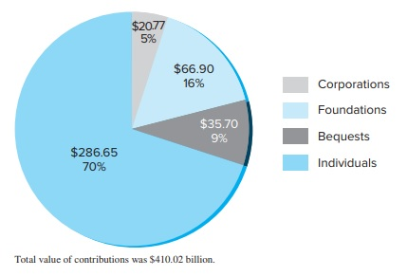
Philanthropy in the United States by Source of Contributions, 2017
Figure 18.3
Copyright © McGraw-Hill Education. Permission required for reproduction or display.
Access the text alternative for these images.

Slide 9
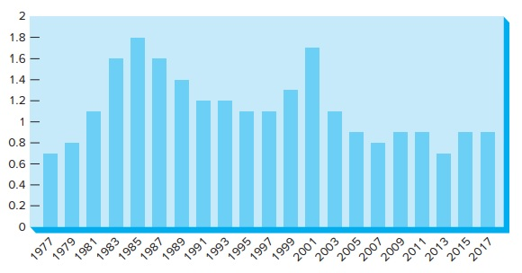
Corporate Contributions in the United States, as a Percentage of Pretax Corporate Profits, 1977-2017
Figure 18.4
Copyright © McGraw-Hill Education. Permission required for reproduction or display.
Access the text alternative for these images.

Slide 10


Corporate Giving3
Some large corporations have established nonprofit corporate foundations to handle their charitable programs.
Three Forms of Corporate Giving
Charitable donations.
In-kind contributions.
Volunteer employee service.
Notes:
Some large corporations have established nonprofit corporate foundations to handle their charitable programs.
Permits them to administer contribution programs more uniformly and provides a central group of professionals that handles all grant requests.
Example: General Motors Foundations’ missions:
To benefit the community.
To help companies implement philanthropic programs that meet this corporate social responsibility.
Three Forms of Corporate Giving
Typically, gifts by corporations and their foundations take one of three forms:
1. Charitable donations (gifts of money).
2. In-kind contributions (gifts of products or services).
Of U.S. corporate contributions in 2016:
18 percent were in-kind (noncash).
48 percent were cash.
The balance came in the form of contributions from affiliated foundations.
Under U.S. tax laws, if companies donate new goods, they may deduct their fair-market value within the relevant limits.
3. Volunteer employee service (gifts of time).
Involves the efforts of people to assist others in the community through unpaid work.
An important trend is what is known as skills-based volunteerism, in which employee skills are matched to specialized needs.
Another approach is for companies to provide employees with paid time off for volunteer service in the community.

Slide 11
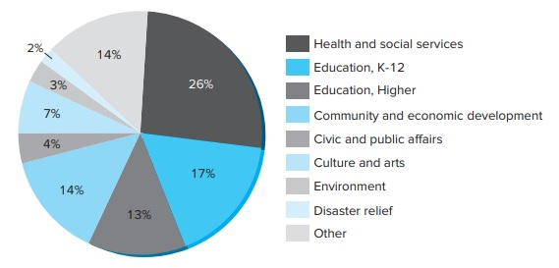
Priorities in Corporate Giving
Figure 18.5
Copyright © McGraw-Hill Education. Permission required for reproduction or display.
Access the text alternative for these images.

Slide 12


Corporate Giving in Strategic Context
Strategic philanthropy
Areas most likely to enhance a company’s competitiveness:
  Factor conditions
  Demand conditions
  Context for strategy and rivalry
  Related and supporting industries
Strategies to Optimize Benefits
Notes:
Strategic philanthropy: Corporate giving that is linked directly or indirectly to business goals and objectives.
In this approach, both the company and society benefit from the gift.
Increasingly popular approach to corporate giving.
Areas in which corporate contributions are most likely to enhance a company’s competitiveness, according to a Harvard Business Review study:
Factor conditions - supply of trained workers, physical infrastructure, and natural resources.
Demand conditions - affect demand for a product or service.
Context for strategy and rivalry - designed to support policies that create a more productive competitive environment.
Related and supporting industries - strengthen related sectors of the economy, may also help companies.
Strategies to Optimize Benefits from Contributions
Strategies:
Draw on the unique assets and competencies of the business.
Align priorities with employee interests.
Align priorities with core values of the firm.

Slide 13

Measuring the Return on Social Investment1
Return on social investment: The benefits that accrue to business and society.
Examining:
Inputs
Outputs
Impacts
Value creation
Notes:
Return on social investment: The benefits that accrue to business and society.
Companies are using standard business tools to measure the outcomes of their investments in the community.
Return on social investment is often more difficult to measure than other kinds of return.
Nevertheless, community relations and corporate giving professionals have made significant advances in developing appropriate metrics as shown on the next slide.
Inputs: The resources companies provide.
They may include cash contributions, employee time, products and services, or logistics support.
Outputs: Measures of the activities that took place.
Usually numerical counts of people and communities served.
Impacts: The difference the program made – the actual benefits that accrued to the people and communities served.
It is similar to outputs, except that it tries to capture the actual results of the gift.
Value creation: The benefits to the business of the program.
This is similar to the concept of enlightened self-interest.

Slide 14
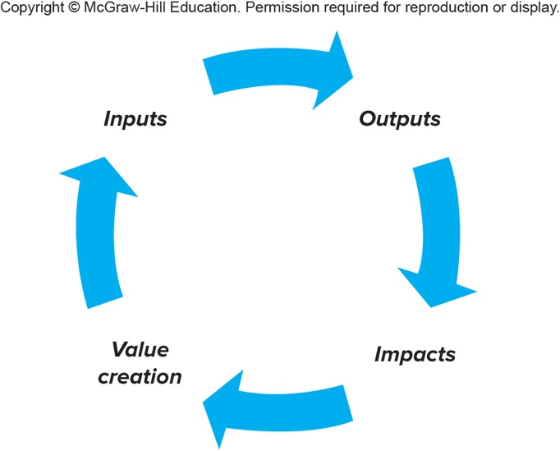
Measuring the Return on Social Investment3
Figure 18.6
Copyright © McGraw-Hill Education. Permission required for reproduction or display.
Access the text alternative for these images.

Slide 15

Building Collaborative Partnerships1
The need for collaborative partnerships is very apparent when dealing with community problems.
Notes:
The need for collaborative partnerships is very apparent when dealing with community problems.
One arena in which collaborative partnerships among business, government, and communities have been particularly effective is education.
Companies rely on educational systems to provide them with well-trained employees equipped for today’s high-technology workplace.

Slide 16
End of Main Content
Notes:
Closing slide.

Slide 17
Accessibility Content:
Text Alternatives for Images

Slide 18
Philanthropy in the United States by Source of Contributions, 2017 Text Alternative
The chart is divided into four sections. The key is listed on the right and contains four color-coded items that read corporations, foundations, bequests, and individuals.
In a clockwise manner of appearance, the segments in the pie chart are labeled as follows:
Corporations – 20.77 billion dollars, 5 percent.
Foundations – 66.90 billion dollars, 16 percent.
Bequests – 35.70 billion dollars, 9 percent.
Individuals – 286.65 billion dollars, 70 percent.
At the bottom of the pie chart, there is text that reads total value of contributions was 410.02 billion dollars.
Return to slide containing original image.

Slide 19
Corporate Contributions in the United States, as a Percentage of Pretax Corporate Profits, 1977-2017 Text Alternative
The x-axis contains twenty-one markings. From the left to the right, these markings read 1977, 1979, 1981, 1983, 1985, 1987, 1989, 1991, 1993, 1995, 1997, 1999, 2001, 2003, 2005, 2007, 2009, 2011, 2013, 2015, and 2017.
The y-axis contains 11 markings. From the bottom to the top, these markings read 0, 0.2, 0.4, 0.6, 0.8, 1, 1.2, 1.4, 1.6, 1.8, and 2.
From left to right the percentages of corporate contributions of pretax profits per year read:
1977 a low point at around 0.7; 1979 about 0.8; 1981 near 1.5; 1983 almost 1.6, 1985 the high point on the graph at 1.8; 1987 around 1.6; 1989 about 1.35; 1991 and 1993 just under 1.2; 1995 and 1997 near 1.1; 1999 approximately 1.3; 2001 the second highest year at 1.7; 2003 about 1.1; 2005 about 0.9; 2007 at 0.8; 2009 and 2011 about 0.9; 2013 the lowest year at just under 0.7; 2015 and 2017 around 0.9.
Return to slide containing original image.

Slide 20
Priorities in Corporate Giving Text Alternative
It is divided into nine sections. The key is mentioned on the right. It contains nine items that read health and social services; education, K-12; education, higher; community and economic development; civic and public affairs; culture and arts; environment; disaster relief; and other.
In a clockwise manner of appearance, the segments in the pie chart are labeled as follows:
Heath and social services - 26 percent;
Education, K-12 - 17 percent;
Education, higher - 13 percent;
Community and economic development - 14 percent;
Civic and public affairs - 4 percent;
Culture and arts - 7 percent;
Environment - 3 percent;
Disaster relief - 2 percent; and
Other - 14 percent.
Return to slide containing original image.

Slide 21
Measuring the Return on Social Investment3
Text Alternative
It contains four terms. Each term is connected to the next via a cyclic arrow.
The first term reads inputs. An arrow arises from the right side of this text and points at the second term that reads outputs. An arrow arises from the bottom of this text and points at the third term that reads impacts. An arrow arises from the left end of this text and points at the fourth term that reads value creation. This term is connected to the first term via a cyclic arrow, thereby illustrating a loop.
Return to slide containing original image.

